Slide 1
Spring Boot & Microservices

Slide 2
Spring Boot - Introduction

Slide 3
Spring Boot Introduction
Spring is widely used for creating scalable applications. For web applications Spring provides Spring MVC
Spring MVC is a widely used module of spring which is used to create scalable web applications.
But main disadvantage of spring projects is that configuration is really time-consuming and can be a bit overwhelming for the new developers.
Solution to this is Spring Boot. Spring Boot is built on the top of the spring and contains all the features of spring. And is becoming favourite of developer’s these days because of it’s a rapid production-ready environment which enables the developers to directly focus on the logic instead of struggling with the configuration and set up.
Spring Boot is a microservice-based framework and making a production-ready application in it takes very less time.

Slide 4
Spring Boot Features
Spring Boot is built on the top of the conventional spring framework. So, it provides all the features of spring and is yet easier to use than spring.
It allows to avoid heavy configuration of XML which is present in spring: Unlike the Spring MVC Project, in spring boot everything is auto-configured. We just need to use proper configuration for utilizing a particular functionality. For example: If we want to use hibernate(ORM) then we can just add @Table annotation above model/entity class(discussed later) and add @Column annotation to map it to table and columns in the database
It provides easy maintenance and creation of REST end points: Creating a REST API is very easy in Spring Boot. Just the annotation @RestController and @RequestMapping(/endPoint) over the controller class does the work.
It includes embedded Tomcat-server: Unlike Spring MVC project where we have to manually add and install the tomcat server, Spring Boot comes with an embedded Tomcat server, so that the applications can be hosted on it.
Deployment is very easy, war and jar file can be easily deployed in the tomcat server: war or jar files can be directly deployed on the Tomcat Server and Spring Boot provides the facility to convert our project into war or jar files. Also, the instance of Tomcat can be run on the cloud as well.

Slide 5
Spring Boot Features
6. Microservice Based Architecture: Microservice, as the name suggests is the name given to a module/service which focuses on a single type of feature, exposing an API(application peripheral interface).Let us consider an example of a hospital management system.
In case of monolithic systems, there will be a single code containing all the features which are very tough to maintain on a huge scale.
But in the microservice-based system, each feature can be divided into smaller subsystems like service to handle patient registration, service to handle database management, service to handle billing etc.
Microservice based system can be easily migrated as only some services need to be altered which also makes debugging and deployment easy. Also, each service can be integrated and can be made in different technologies suited to them.

Slide 6
Spring Boot Architecture

Slide 7
Spring Boot Architecture
To understand the architecture of Spring Boot, let us first see different layers and classes present in it.
Layers in Spring Boot: There are four main layers in Spring Boot:
Presentation Layer: As the name suggests, it consists of views(i.e. frontend part)
Data Access Layer: CRUD (create, retrieve, update, delete) operations on the database comes under this category.
Service Layer: This consist of service classes and uses services provided by data access layers.
Integration Layer: It consists of web different web services(any service available over the internet and uses XML messaging system).
Then we have utility classes, validator classes and view classes.
All the services provided by the classes are implemented in their corresponding classes and are retrieved by implementing the dependency on those interfaces.

Slide 8
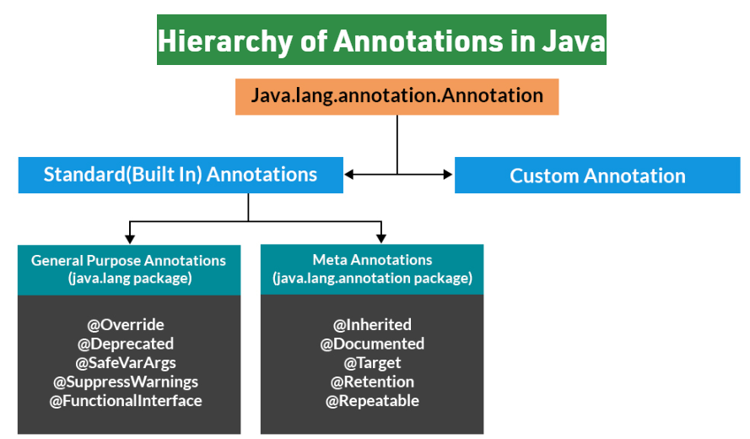
Hierarchy of Annotations in Java

Slide 9
Spring Boot Annotations
Spring Annotations are a form of metadata that provides data about a program. Annotations are used to provide supplemental information about a program. It does not have a direct effect on the operation of the code they annotate. It does not change the action of the compiled program.
Spring annotations present in the org.springframework.boot.autoconfigure and org.springframework.boot.autoconfigure.condition packages are commonly known as Spring Boot annotations.
A brief on annotations in Java
Annotations are used to provide supplemental information about a program.
Annotations start with ‘@’.
Annotations do not change the action of a compiled program.
Annotations help to associate metadata (information) to the program elements i.e. instance variables, constructors, methods, classes, etc.
Annotations are not pure comments as they can change the way a program is treated by the compiler. See below code for example.
Annotations basically are used to provide additional information, so could be an alternative to XML and Java marker interfaces.

Slide 10
Spring Boot Annotations
Some of the annotations that are available in this category are:
@SpringBootApplication
@SpringBootConfiguration
@EnableAutoConfiguration
@ComponentScan
Auto-Configuration Conditions
@ConditionalOnClass, and @ConditionalOnMissingClass
@ConditionalOnBean, and @ConditionalOnMissingBean
@ConditionalOnProperty
@ConditionalOnResource
@ConditionalOnWebApplication and @ConditionalOnNotWebApplication
@ConditionalExpression
@Conditional

Slide 11
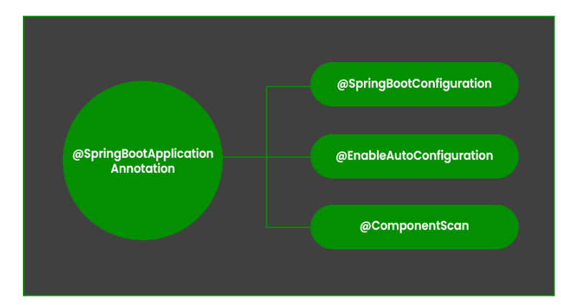
Spring Boot Annotations
@SpringBootApplication Annotation
This annotation is used to mark the main class of a Spring Boot application.
It encapsulates @SpringBootConfiguration, @EnableAutoConfiguration, and
@ComponentScan annotations with their default attributes.

Slide 12
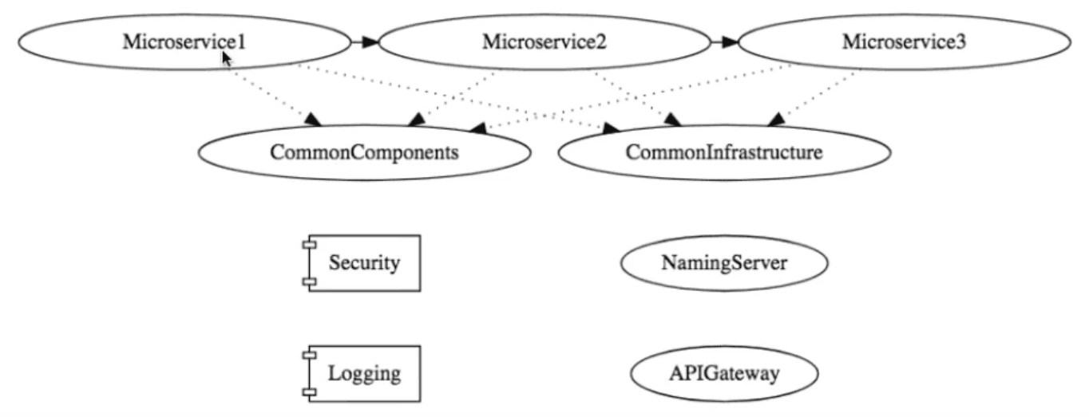
Microservices Synchronous Communication

Slide 13
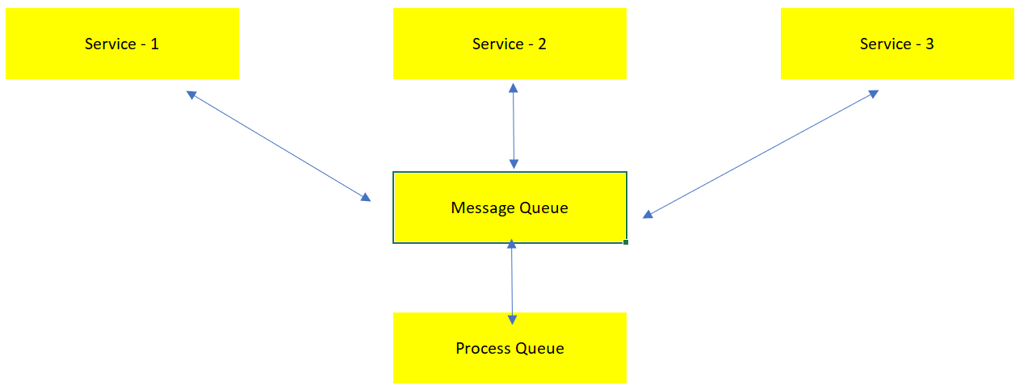
Microservices Asynchronous Communication

Slide 14
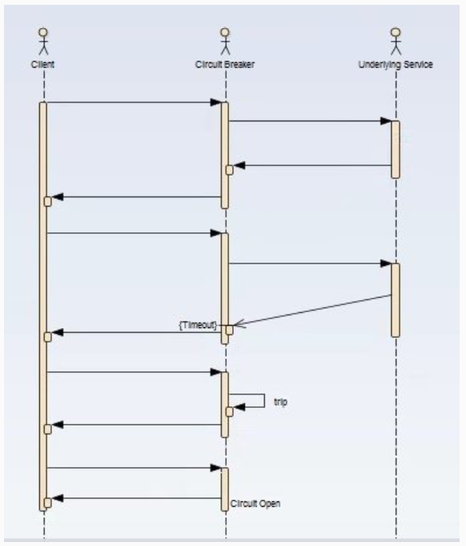
Circuit Breaker Pattern

Slide 15
Thank You

